Slide 1
Rhino search challenge
Kenyatta University, 21.01.2025

Slide 2
Background
Ol Pejeta is home to the last two remaining northern white rhinos, and a sanctuary for over 165 critically endangered black rhinos.
The black rhinos need to be seen every 3 days.
If that’s not the case, search parties are sent out in the parc until they find the missing rhino.
Drones might be able to help this effort!

Slide 3
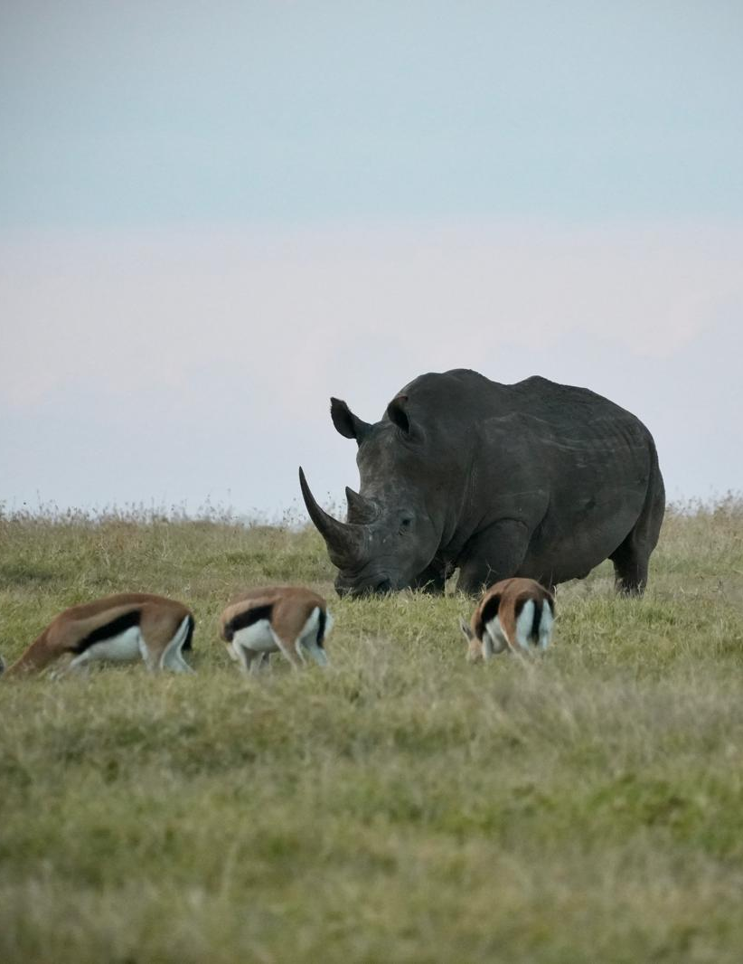
Rhino search challenge
Each team gets to control a drone in Ol Pejeta
The drone is equipped with a rhino range sensor and a downward-facing camera
The range sensor has a detection range of 200m.
The camera has a field of view of 50m on the ground.
Your goal is to find a strategy to find and take a picture of all the rhinos in the park.

Slide 4
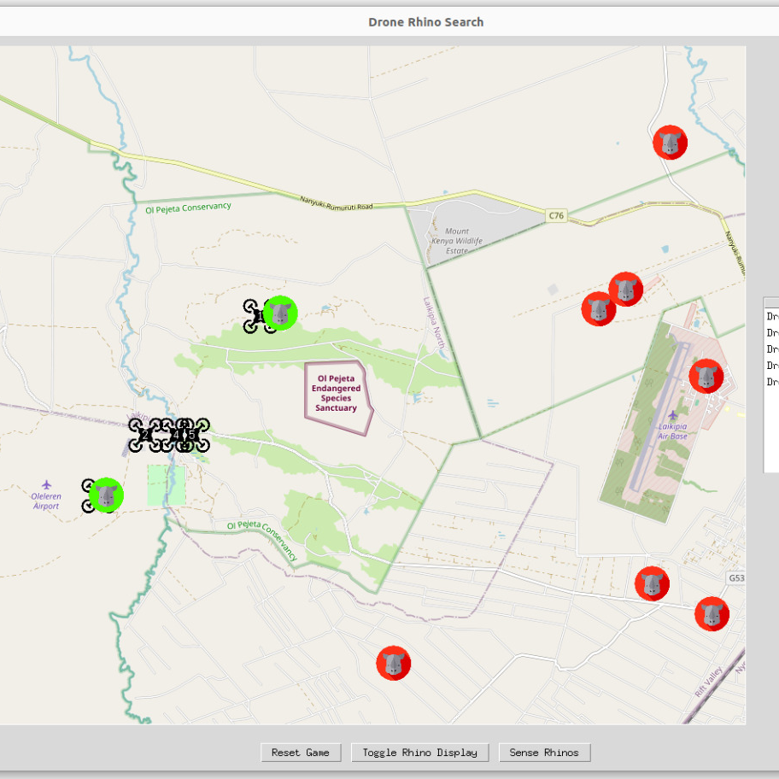
Practicals
Remote simulated drones
Try different search strategies
Software with holes to fill

Slide 5
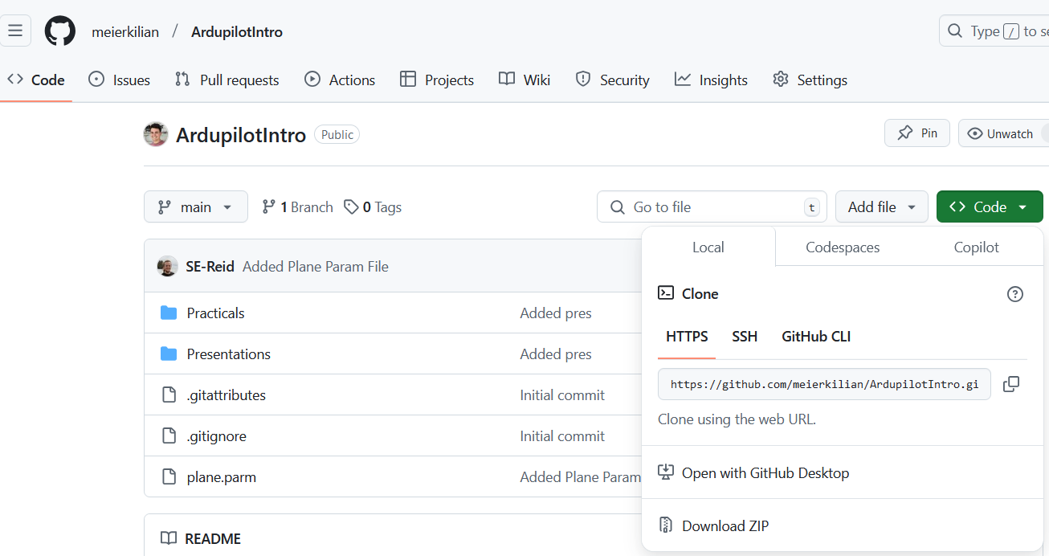
Download today’s scripts
https://github.com/meierkilian/ArdupilotIntro
Extract it!

Slide 6
Installing python packages
Packages
Open terminal (WIN+R, then type “cmd” and press Enter)
pip install numpy
pip install dronekit
pip install pymap3d
Run helloworld.py
Change directory to the folder “Practicals/RhinoChallenge”
python helloworld.py
Open “rhinoChallengeTasks.py” in your favourit text/code editor

Slide 7
TASK 1: is a waypoint reached?
How can we check if a waypoint is reached?

Slide 8
TASK 2: wait until a waypoint reached?
How can we send a drone to a waypoint and then wait until it reached it?

Slide 9
TASK 3: Connect to the drone
Connect to local network
SSID: ANVLAN729
Password: ministrylevel369
Fill in the system ID of your group
See the screen for your group IP address and port

Slide 10
TASK 4: run the manual search
Can you find any rhino?
Is it a convenient way of searching?

Slide 11
TASK 4: run the manual search
Can you find any rhino?
Is it a convenient way of searching?

Slide 12


TASK 5: Search Patterns
Lawnmower
Spiral

Slide 13
TASK 5: lawnmower pattern
pNW
pNE
Explain what those 4 lines do.
What are pNW, pNE and PSW?
Why divided by sensorRange?
What about 2**0.5?
Why +1?
What does the linspace() function do?
pSW

Slide 14
TASK 6: run the lawnmower search
Can you find any rhino?
Is it more efficient than manual search?
What is the drawback of this search?

Slide 15


TASK 7: triangulation
How should we use the range finder?

Slide 16
TASK 7: triangulation
How should we use the range finder?

Slide 17
TASK 7: triangulation
How should we use the range finder?

Slide 18
TASK 8: run the triangulation search
Can you find any rhino?
Is it more efficient than the lawnmower search?
Do you think a rhino ranger finder is something we can build?

Slide 19
Conclusion
Give an overview of how to design and conduct a safe semi-autonomous drone (quadcopter) operation in the context of wildlife conservation.
Autopilot software and simulation (Ardupilot)
Ground Control Station software (Mission planner)
Communication protocol (Mavlink)
Safe operation (SORA)
Practical work

Slide 20
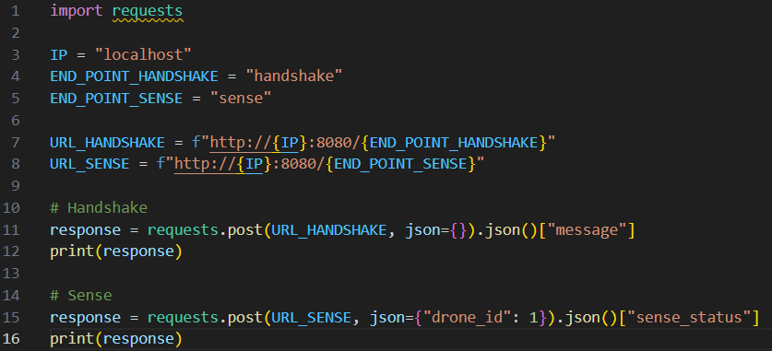
Accessing the sensor
Send a sense request to the sensor.
Returns
{"state": "out_of_range", "distance": -1}
{"state": "found", "distance": <dist>}
{"state": "in_range", "distance": <dist>}
Sensor characteristics
The range sensor has a detection range of 200m.
The camera has a field of view of 50m on the ground.

